Slide 1


Systematic analysis of neural networks performance and generalization capabilities with application to the automatic assessment of
Lung Ultrasound data from Covid-19 patients
ZIHADUL AZAM
19 October 2022
Artificial Intelligence Systems

Slide 2
1. Introduction

Slide 3
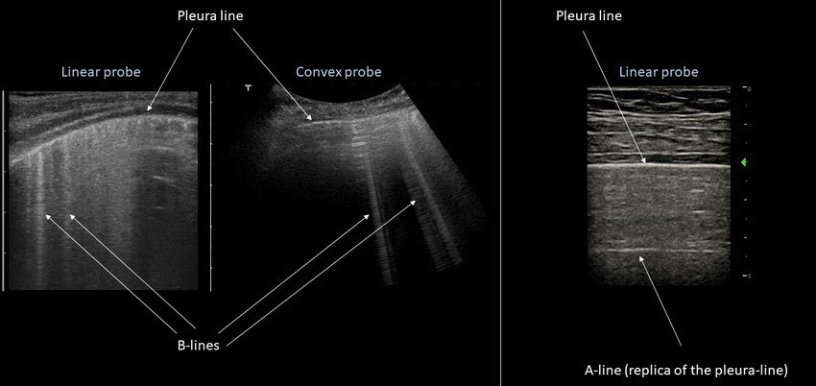
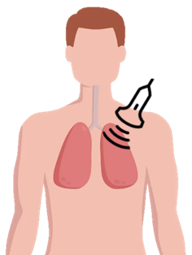
Lung Ultrasound (LUS) and COVID-19
Covid-19 virus can cause Pneumonia.
Covid-19 Pneumonia: the lungs become filled with fluid and inflamed.
Clinicians use LUS to assess the lungs condition by evaluating the presence of artifacts in images.

Slide 4
Role of Deep Learning
During the pandemic different DL techniques have been employed to automate the evaluation process in order to support clinicians.
But majority of them were solutions based on novel architecture or combination of different DL techniques.
Only few studies have been conducted on the application of the state-of-the-art networks applied on LUS data.
For this reason, this work is focused only on state-of-the-art models.

Slide 5
2. Goals

Slide 6
Goals
How State-of-the-art CNNs perform with LUS data?
Do they have a good generalization capability?
How much data is required to build a model with compareable performance?
Explainable AI?

Slide 7
3. Dataset

Slide 8
ICLUS-DB Dataset
05
35
277
58’924
Brescia
Rome
Lucca
Tione
Pavia
+
Clinics
Patients
Videos
Frames

Slide 9
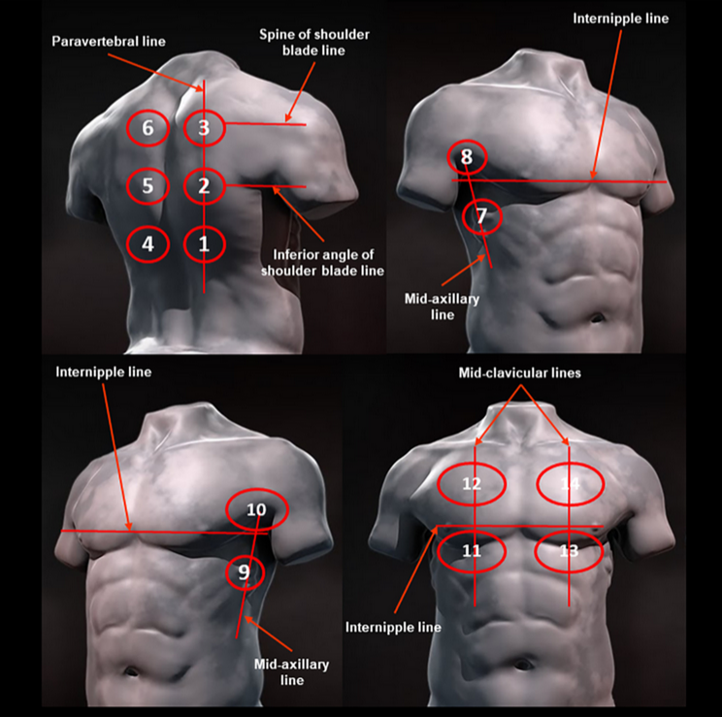
Standard Acquisition Protocol
14 areas:
4 front
4 lateral
6 back
“Proposal for International Standardization of the Use of Lung Ultrasound for Patients With COVID-19”
- G. Soldati et al, 2020

Slide 10
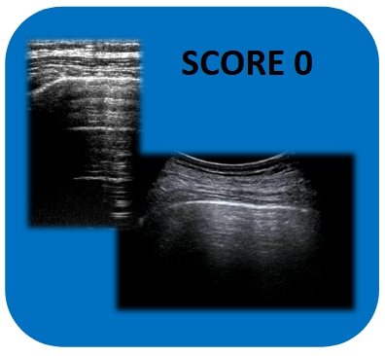
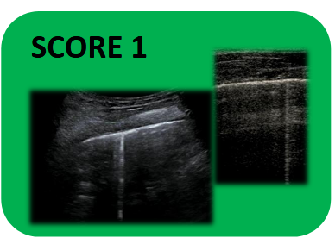
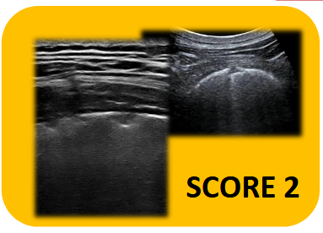
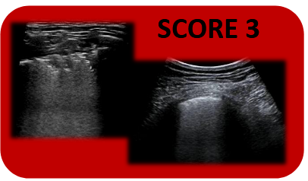
Data labelling
WORSENING
4 level scoring system:
Score 0
Score 1
Score 2
Score 3
IMPROVEMENT
“Proposal for International Standardization of the Use of Lung Ultrasound for Patients With COVID-19”
- G. Soldati et al, 2020

Slide 11
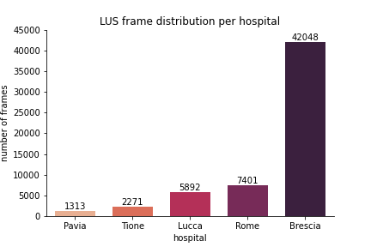
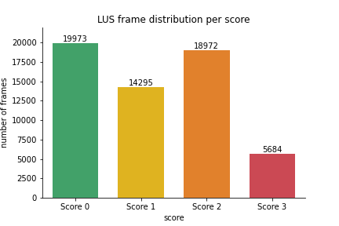
Dataset statistics

Slide 12
4. Methodologies & Results

Slide 13
Methodologies
Frame-level scoring system
Grad-CAM algorithm
Generalization Capability across different medical centers

Slide 14
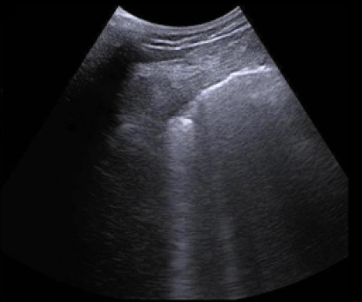
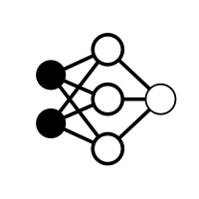
1. Frame-level scoring system
Model
Score 0
Score 1
Score 2
Score 3
LUS Frame

Slide 15
Model Architectures
ResNet-18
ResNet-50
ResNet-101
DensNet-121
DensNet-201
InceptionV3
Model

Slide 16
Data splitting
Patient level
Total:
35 Patients
58’924 frames
Training Data
Testing Data
≈ 60% (24 patients)
48’215 frames
≈ 40% (11 patients)
10’710 frames

Slide 17
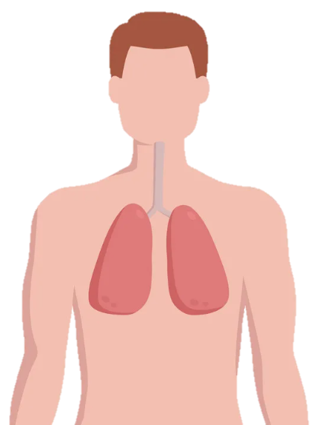
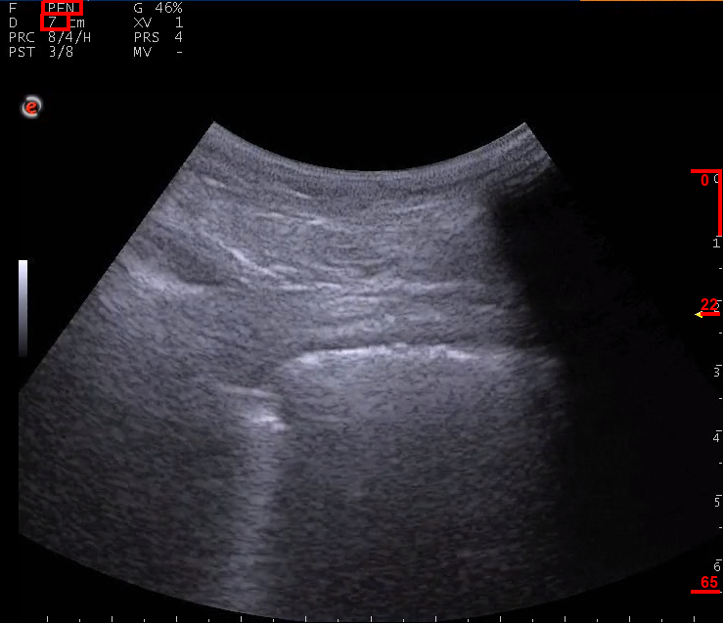
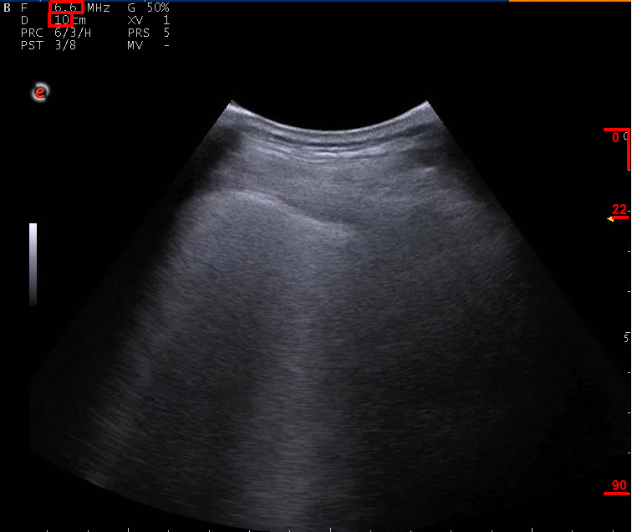

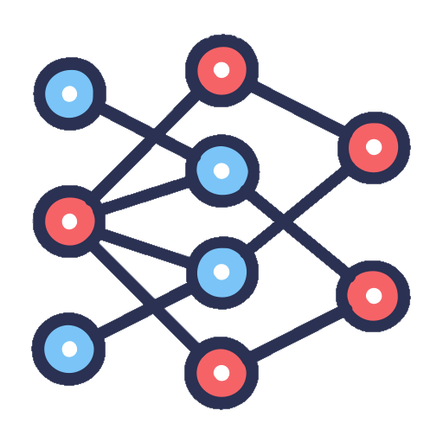

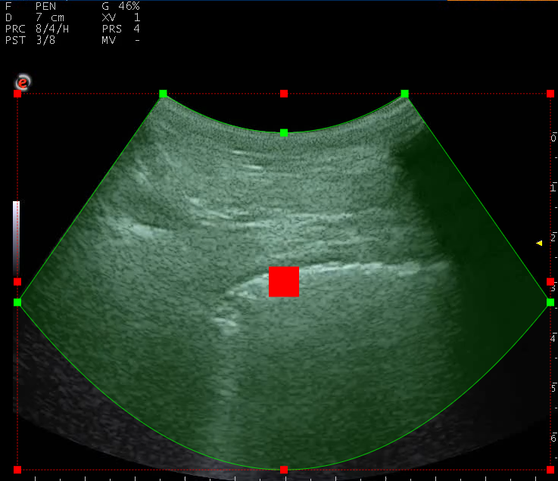
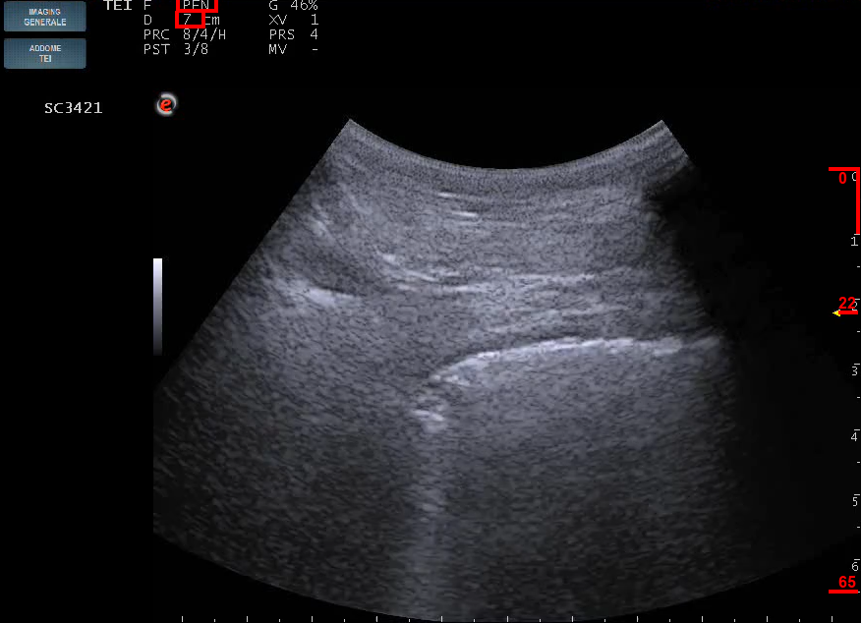
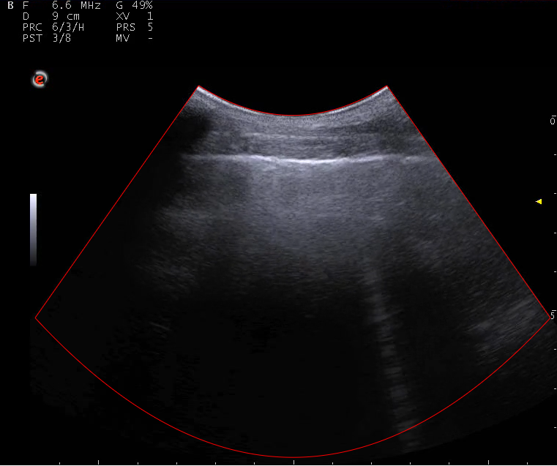
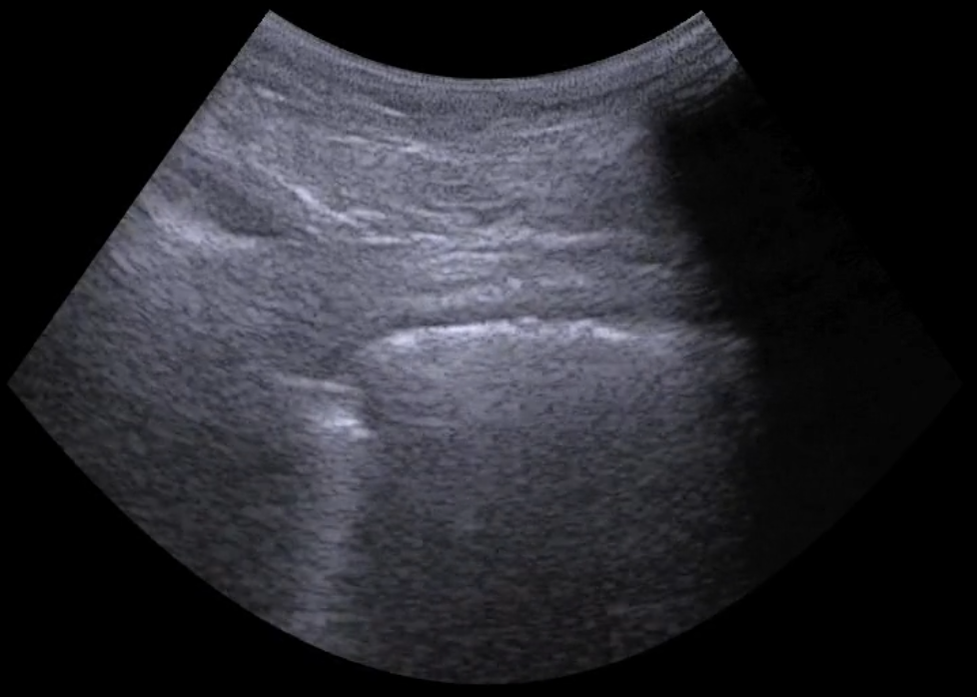
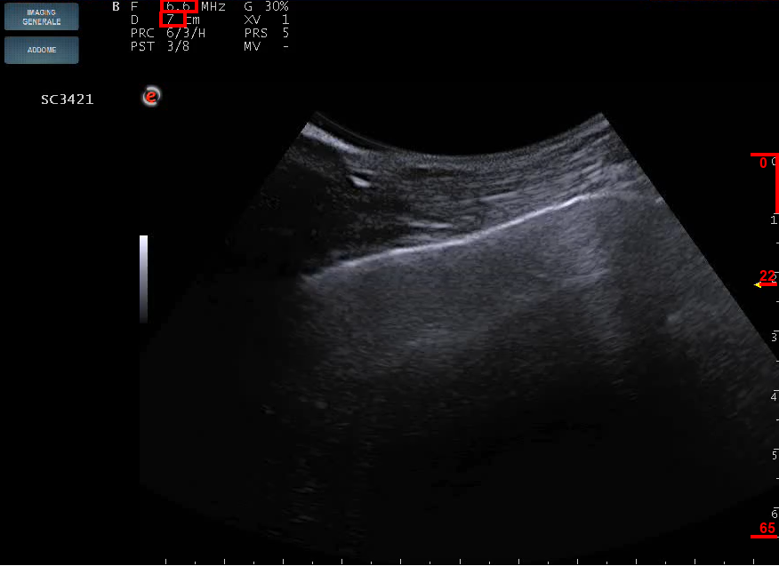
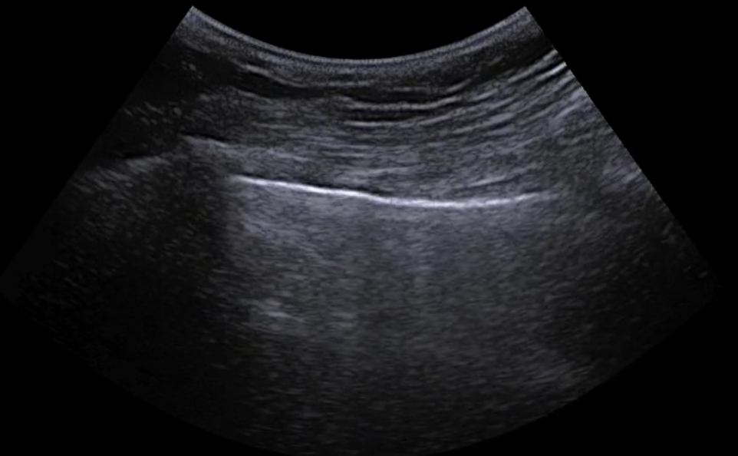

Training Outputs
I₀ | I₁ | I₂ | I₃ | I₄
S3 | S0 | S1 | S1 | S2
Testing Outputs
J₀ | J₁ | J₂ | J₃ | J₄
S1 | S2 | S1 | S2 | S0
Score-2
Score-3
Back
propagation
Prediction
Prediction
Score-2
Original Image
Data
Acquisition
Score-2
Trained model
5 steps of Frame-level scoring system
Score-1
CNN Model
Testing
Training
Cropping Mask
I₀
J₀
I₁
Score-3
J₁
Score-1
Data
Storage
Score-0
Score-2
Score-0
Score-3
I₂
Score-1
Score-1
Score-0
J₂
Score-2
Score-2
Score-0
I₃
J₃
I₄
J₄
Train
Dataset
Test
Dataset
Cropped Image
1. Data Collection
2. Data Labelling
3. Data Cropping
4. Model Training
5. Model Evaluation

Slide 18
1. Frame-level scoring system: Results
Methodology | Employed Model and Technique | F1-Score
 | Reg + STN + CNN [1] | 0.651
Base line | ResNet-18 + Annotations [2] | 0.688
 | ResNet-18 | 0.659
 | ResNet-50 | 0.655
Proposed | ResNet-101 | 0.651
 | DensNet-121 | 0.6513
 | DesnsNet-201 | 0.6517
 | InceptionV3 | 0.612
Proposed Pre-Trained | ResNet-18 | 0.645
[1] S. Roy et al, Deep learning for classification and localization of covid-19 markers in point-of-care lung ultrasound, 2020
[2] O. Frank et al, Integrating domain knowledge into deep networks for lung ultrasound with applications to covid-19, 2021

Slide 19
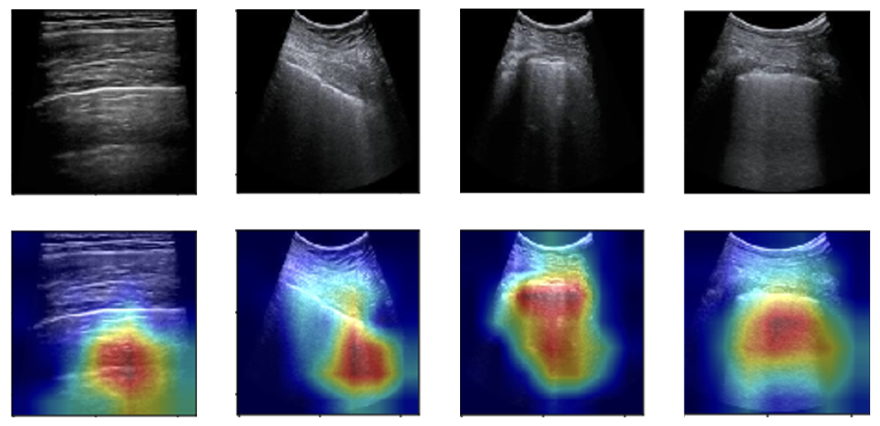
2. Grad-CAM on ResNet-18 (trained from scratch)
Score 0
Score 1
Score 2
Score 3

Slide 20

3. Generalization Capability – 1
Brescia
Rome
Lucca
Tione
Pavia
Back-propagation
Training:
Predictions
Brescia
Testing:
Predictions
Trained model
Rome

Slide 21
3. Generalization Capability – 2
1 patient
Back-propagation
Training
(Brescia)
N/2 patients
Predictions
N-1 patients
Testing
(Rome):
Predictions
Trained model

Slide 22
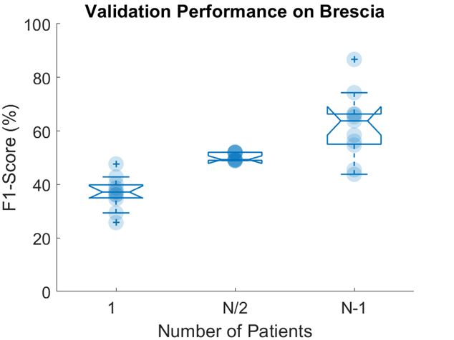
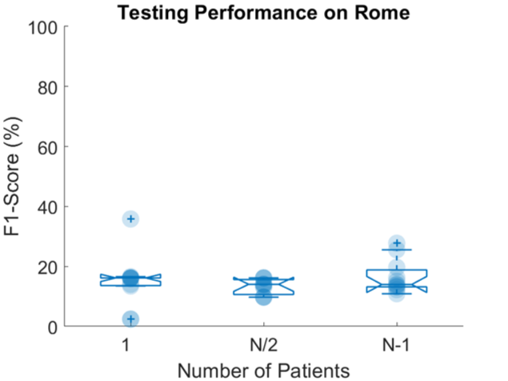
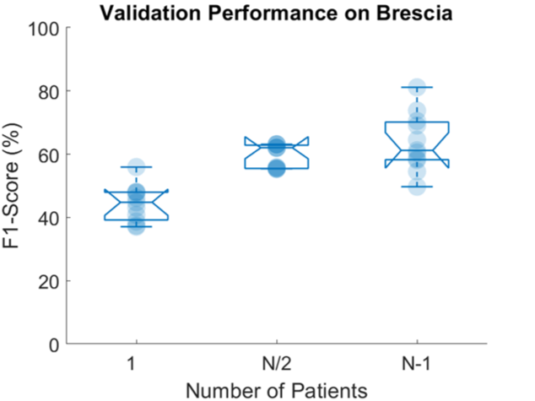
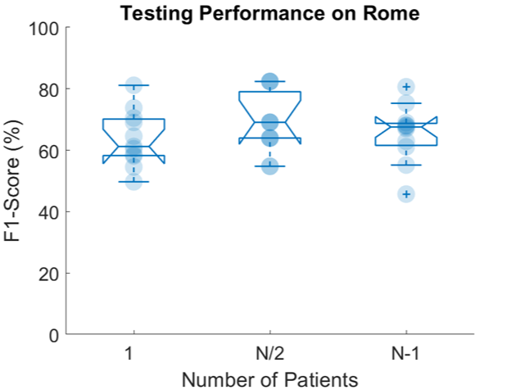
Generalization Capability: Results
ResNet-18
Trained from scratch
ResNet-18
Pre-trained

Slide 23
Conclusion
Outperforming results were achieved by using state-of-the-art CNN models.
ResNet-18 was found to be the best-performing model with an F1-Score of 0.659.
Grad-CAM algorithm helped to understand model behaviors.
Pre-trained model has better generalization capabilities.
Half of training patients were enough to achieve comparable performance.
Future works: transformer-based models, video-level classification.

Slide 24

Thank You !
For Your Attention
19 October 2022
Artificial Intelligence Systems
By: Zihadul Azam

